Slide 1

Services
*Each pod gets its own ip address, however in an deployment, the set of pods running in one moment in time could be different from the set of pods, running that the application a moment later.
*This leads a problem: if some set of pods (call them backend) provides functionality to other pods (call them front end ) inside your cluster how to the frontend find out and keeps track of which ip address to connect to , so that the front end use the backend part of the workload.
*Although each pod has its unique ip address are those ip’s are not exposed outside the cluster.
*lables are use to select which are the pods to be put under a service.
*Creating a service will create an endpoint to access the pods/application in it.

Slide 2
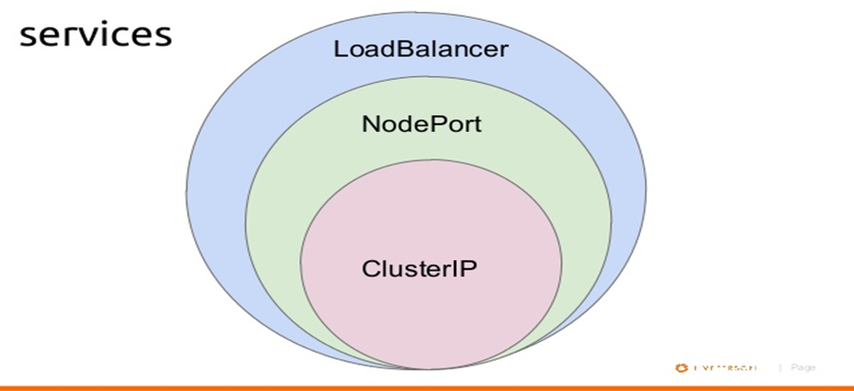
*Services an be exposed in different ways by specifying a type in the service spec.
-cluster
-Node port
-Load balancer
*containers within a pod use networking to communicate via loopback.
*cluster networking provides communication between different pod.
*container to container communication on same pod happens through localhost within the container.
*The server resources let you expose an application running in pods to be reachable from outside your cluster.

Slide 3
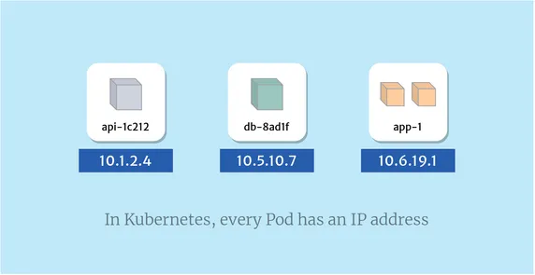
Pod to pod communication
*Pod to Pod communication on the worker node happens through pod ip.
*By default pods ip will not accessible outside the node.
*In Kubernetes, each Pod has its own IP address. At a very primitive level, Pods can communicate with each other using their IP address.
*This means that whenever you need to address another Pod, you can do it directly, using its IP address. This gives Pods similar characteristics to virtual machines (VMs), where each Pod has its own IP address, can expose ports, and address other VMs on the network by IP address and port.

Slide 4
ClusterIP
*ClusterIP (default): Internal clients send requests to a stable internal IP address.
*A ClusterIP service is the default Kubernetes service. It gives you a service inside your cluster that other apps inside your cluster can access. There is no external access.
*Kubernetes will assign a cluster-internal IP address to ClusterIP service. This makes the service only reachable within the cluster.
*You cannot make requests to service (pods) from outside the cluster. You can optionally set cluster IP in the service definition file.
*Use Cases:-
Inter-service communication within the cluster. For example, communication between the front-end and back-end components of your app.

Slide 5
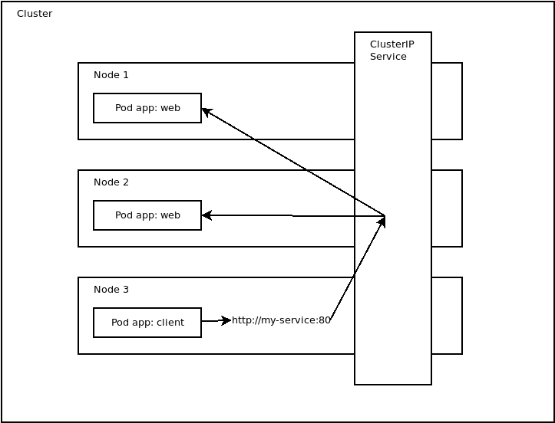
Cluster ip configuration
apiVersion: v1
kind: Service
metadata:
name: my-service
spec:
type: ClusterIP
selector:
app: web
ports:
- protocol: TCP
port: 80
targetPort: 8080

Slide 6
NodePort
*NodePort: Clients send requests to the IP address of a node on one or more nodePort values that are specified by the Service.
*NodePort service is an extension of ClusterIP service. A ClusterIP Service, to which the NodePort Service routes, is automatically created.
*It exposes the service outside of the cluster by adding a cluster-wide port on top of ClusterIP.
*NodePort exposes the service on each Node’s IP at a static port (the NodePort). Each node proxies that port into your Service. So, external traffic has access to fixed port on each Node. It means any request to your cluster on that port gets forwarded to the service
*Node port must be in the range of 30000–32767. Manually allocating a port to the service is optional. If it is undefined, Kubernetes will automatically assign one.
*Use Cases:-
i) When you want to enable external connectivity to your service.
ii) Kubernetes, or even to expose one or more nodes’ IPs directly. Prefer to place a load balancer above your nodes to avoid node failure.

Slide 7
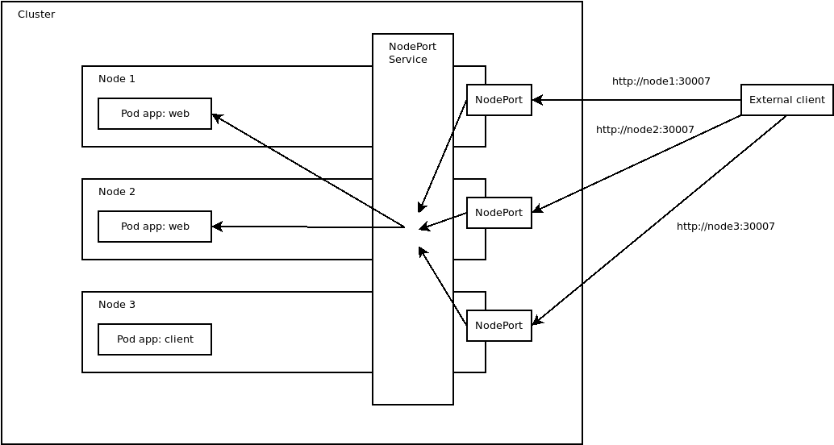
Nodeport configuration
apiVersion: v1
kind: Service
metadata:
name: my-nodeport-service
spec:
selector:
app: my-app
type: NodePort
ports:
- name: http
port: 80
targetPort: 80
nodePort: 30036
protocol: TCP

Slide 8
Loadbalancer
*LoadBalancer: Clients send requests to the IP address of a network load balancer.
*LoadBalancer service is an extension of NodePort service. NodePort and ClusterIP Services, to which the external load balancer routes, are automatically created.
*It integrates NodePort with cloud-based load balancers.
*A LoadBalancer service is the standard way to expose a service to the internet. On GKE, this will spin up a Network load balancer that will give you a single IP address that will forward all traffic to your service.
*It exposes the Service externally using a cloud provider’s load balancer.
*Each cloud provider (AWS, Azure, GCP, etc) has its own native load balancer implementation. The cloud provider will create a load balancer, which then automatically routes requests to your Kubernetes Service.
*Traffic from the external load balancer is directed at the backend Pods. The cloud provider decides how it is load balanced.

Slide 9
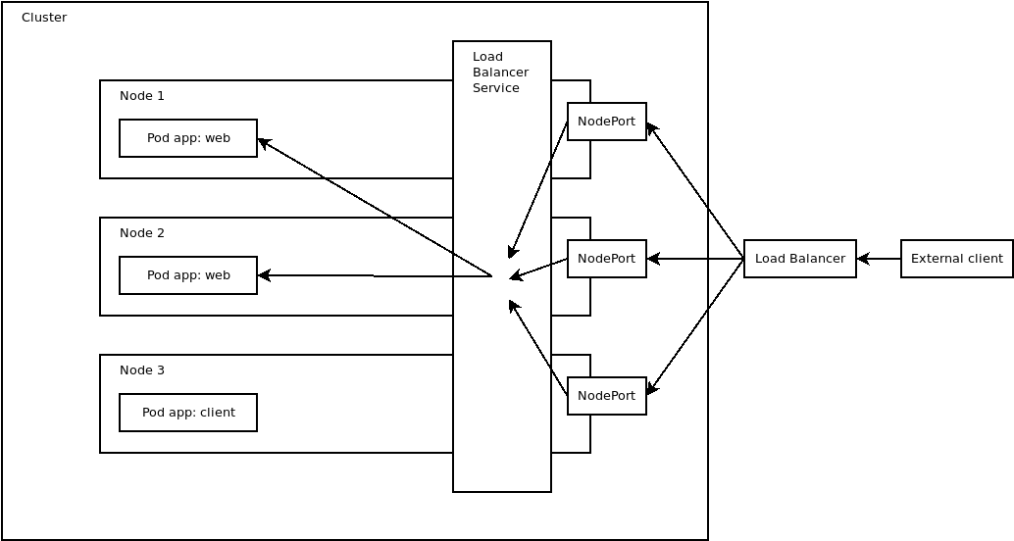
Loadbalancer configuration
apiVersion: v1
kind: Service
metadata:
name: my-service
spec:
type: LoadBalancer
selector:
app: web
ports:
- protocol: TCP
port: 80
targetPort: 8080

Slide 10
Feature | ClusterIP | NodePort | LoadBalancer
Exposition | Exposes the Service on an internal IP in the cluster. | Exposing services to external clients | Exposing services to external clients
Cluster | This type makes the Service only reachable from within the cluster | A NodePort service, each cluster node opens a port on the node itself (hence the name) and redirects traffic received on that port to the underlying service. | A LoadBalancer service accessible through a dedicated load balancer, provisioned from the cloud infrastructure Kubernetes is running on
Accessibility | It is default service and Internal clients send requests to a stable internal IP address. | The service is accessible at the internal cluster IP-port, and also through a dedicated port on all nodes. | Clients connect to the service through the load balancer’s IP.
Yaml Config | type: ClusterIP | type: NodePort | type: LoadBalancer
Port Range | Any public ip form Cluster | 30000 - 32767 | Any public ip form Cluster
User Cases | For internal communication | Best for testing public or private access or providing access for a small amount of time. | widely used For External communication

Slide 11
Volumes
*Containers are short lived lived in nature .
*All data stored inside a container is deleted if the container crashes, However the kubelet will restart with a clean state which means that it will not have any of the old data.
* To overcome this problem kubernetes uses volumes . A volume is essentially a directory
Backed by a storage medium . The storage medium and its content are determined by the volume type.
*in kubernetes volume is attached to a pod and shared among the containers of that pod.
*The volume has the same life span as the pod . And it outlives the container of the pod this allows data to be preserved across container restarts.

Slide 12
Volume types
*A volume type decides that the properties of the directory like size, context, etc some eg of volume types are-
*node local type such as emptydir and hostpath.
*file sharing type such as a nfs (network file system).
*cloud providers specific type like awselasticblockstore, azuredisk.
*special purpose types like secret, gitrepo

Slide 13
EmptyDir
*Use this when we want to share contents between multiple containers on the same pod and not to be host machine.
*An emptydir volume is first created when a pod is assigned a node and exit as long as a pod is running on that node.
*As the name says it initially empty.
*Containers in the pod can all read and write the same files in the emptydir volume through that volume to be mentioned at the same or different in each container.
*when a pod is removed from a node for any reason the data in the pod will deleted forever.
*A container crashing does not remove a pod from a node so the data in an emptydir volume is safe across container crashes.

Slide 14
hostpath
*Use this when we want to access the content of a pod/container from host machine.
*A hostpath volume mounts a file or directory from the host nodes file system into your pod.
*A hostPath volume mounts a file or directory from the node's filesystem into the Pod. You can specify whether the file/directory must already exist on the node or should be created on pod startup.
Persistent volume
*Persistent volume (PV) is a piece of storage provided by an administrator in a Kubernetes cluster.
*in order to use pv you need to claim it first, using a (pvc) persistent volume claim.
*The pvc request a pv with your desired specification (size, access, modes etc) from kubernetes and once a suitable persistent volume is found , it is bount to a persistent volume claim
*After a successful bound to a pod you can mount it as volume.

Slide 15
Configuration of EmptyDir
# nginx-emptydir.yaml
apiVersion: v1
kind: Pod
metadata:
name: nginx-emptydir
spec:
containers:
- name: nginx-container
image: nginx
volumeMounts:
- name: test-vol
mountPath: /test-mnt
volumes:
- name: test-vol
emptyDir: {}
Configuration of Hostpath
apiVersion: v1
kind: Pod
metadata:
name: nginx-hostpath
spec:
containers:
- name: nginx-container
image: nginx
volumeMounts:
- mountPath: /test-mnt
name: test-vol
volumes:
- name: test-vol
hostPath:
path: /test-vol

Slide 16
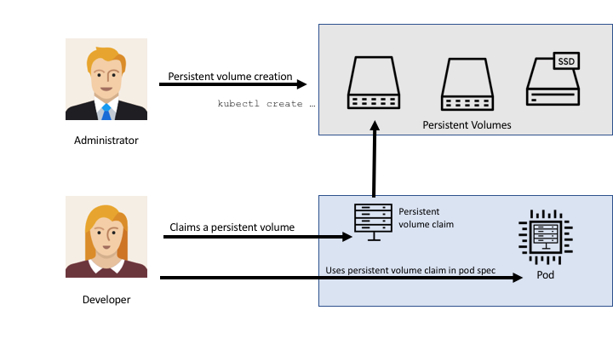
Creating Persistent volume
kind: PersistentVolume
apiVersion: v1
metadata:
name: store-persistent-volume
namespace: test
spec:
storageClassName: hostpath
capacity:
storage: 2Gi
accessModes:
- ReadWriteOnce
hostPath:
path: "/Volumes/Data/data"
Claiming persistent volume
kind: PersistentVolumeClaim
apiVersion: v1
metadata:
name: store-persistent-volume-claim
namespace: test
spec:
storageClassName: hostpath
accessModes:
- ReadWriteOnce
resources:
requests:
storage: 1Gi

